Slide 1

THE SHOPPING ANNUITY
GAME CHANGER or NEW GAME?
Notes:
9
11

Slide 2
Convert Spending into Earning!
MAGIC or MIRACULOUS?
Where else can you do that?
Notes:
9
11

Slide 3
Three Levels of Monetization
  Paid to Shop and Share for you and your customers. Real Money. It adds up.
  Shopping Annuity– Before any customers or retail. You are in business and so is each UFO on your team. Convert spending into earning. Save before you spend. Convert Spending into Shopping annuity and build a residual income. How much can you find to put into it?
  MPCP based on use, Building and Base 10 X 7 strong and share of customer. Retail profits and Residual income from BV, IBV and IBV advertising bonus.
Notes:
3

Slide 4


Cashback
Customer Bait
Notes:
4

Slide 5
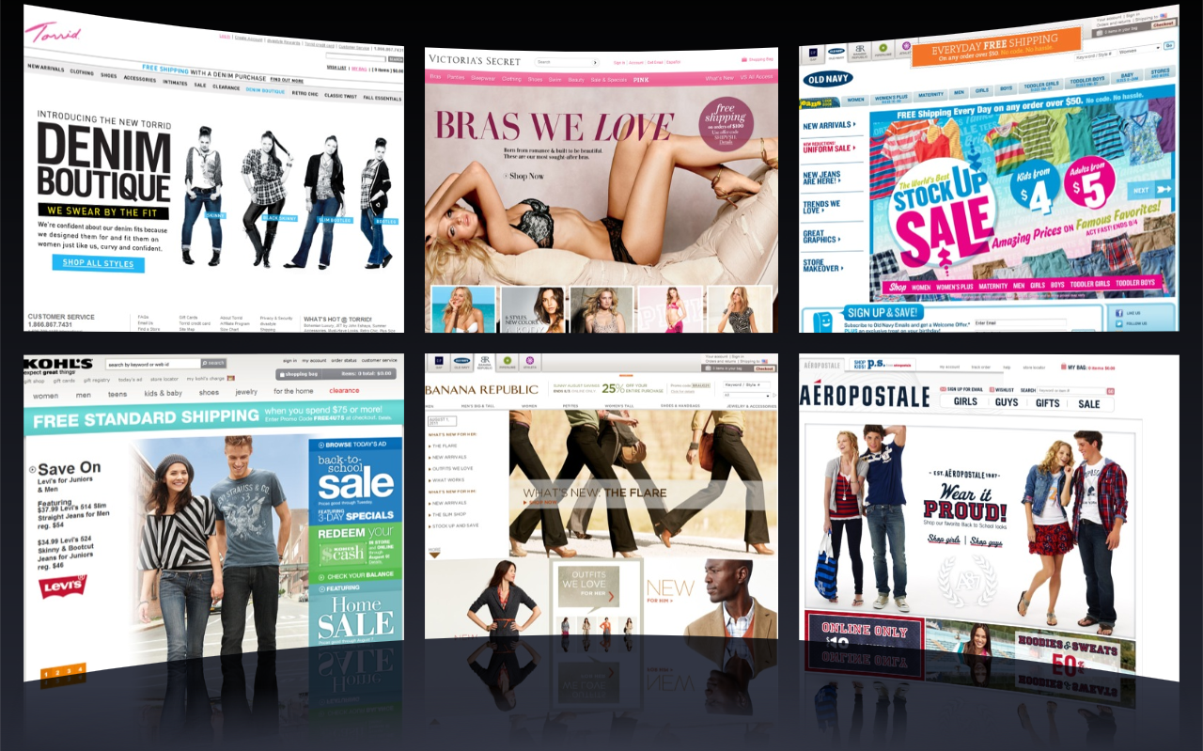
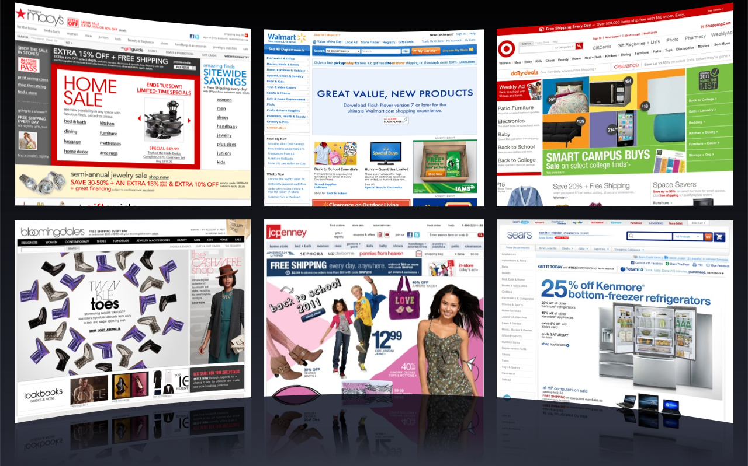
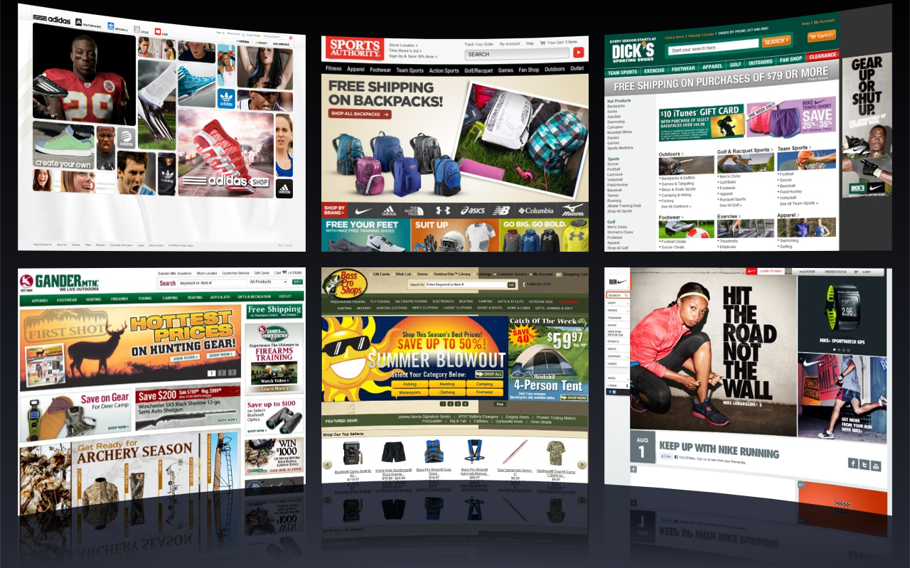
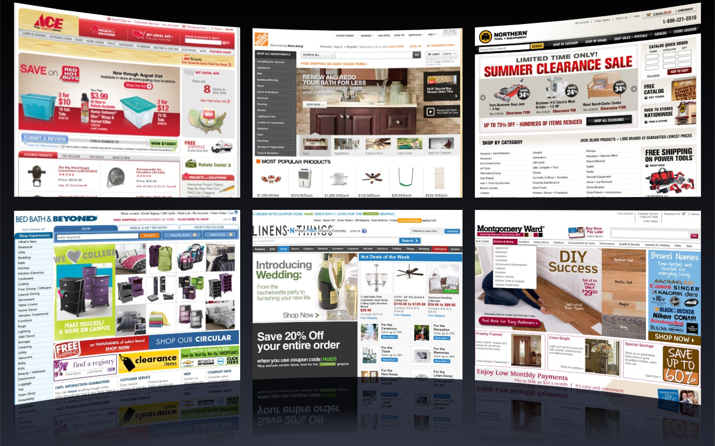
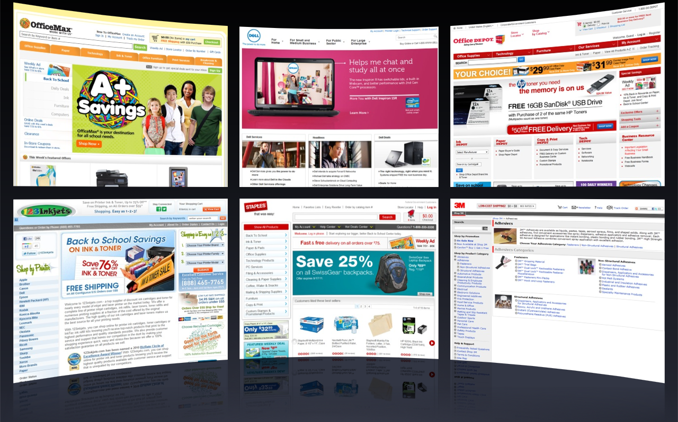
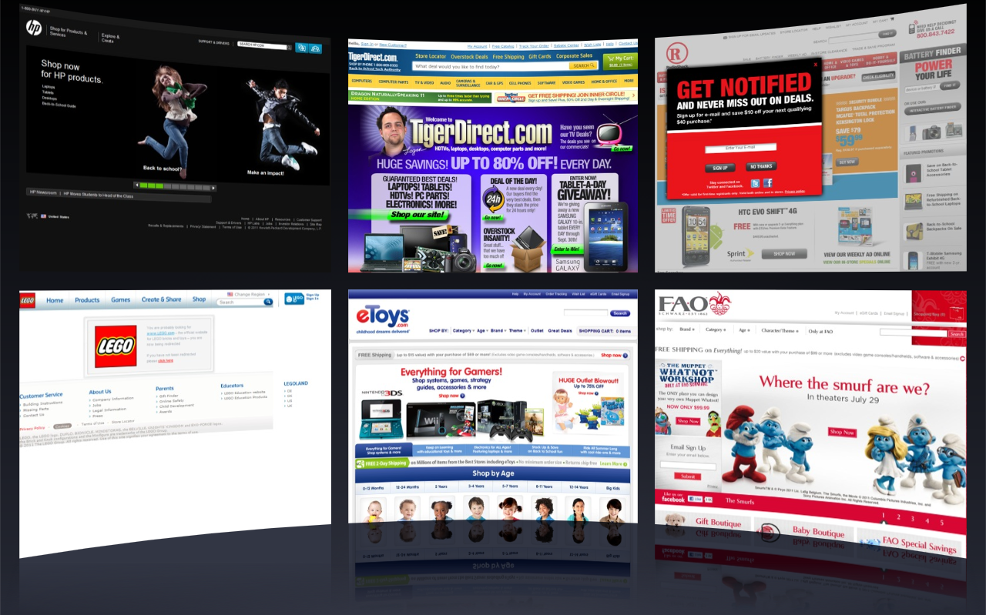
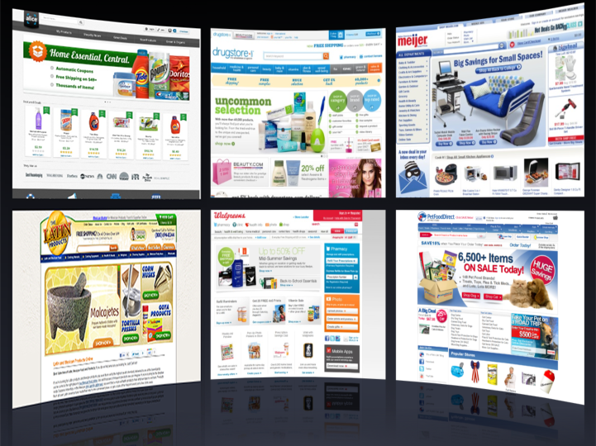










































Apparel
Department Stores
Sports & Outdoors
Home and Garden
Office Supplies
Consumables
Electronics, Toys & Games

Slide 6
SHOPPING ANNUITY FUNDING PLAN
P
P
P
P
P
P
P
P
P
P
P
P
P
P
P
P
P
P
P
P
P
P
P
P
P
P
P
P
P
P
P
P
$600
P
P
P
P
P
P
P
P
P
P
$600
$600
P
P
P
P
P
P
P
P
P
P
$600
400 BV
400 BV
400 BV
400 BV
P
P
P
P
P
P
P
P
P
P
P
P
P
P
P
P
P
P
P
P
P
P
P
P
P
P
P
P
P
P
P
P
P
P
P
P
P
P
P
P
P
P
P
P
P
P
P
P
P
P
P
P
P
P
P
P
P
P
P
P
P
P
P
P
P
P
P
P
P
P
P
P
P
P
P
P
P
P
P
P
P
P
P
P
P
P
P
P
P
P
P
P
P
P
P
P
P
P
P
P
P
P
P
P
P
P
P
P
P
P
P
P
P
P
P
P
P
P
P
P
P
P
P
P
P
P
P
P
P
P
P
P
P
P
P
P
P
P
P
P
P
P
P
P
P
P
P
P
P
P
P
P
P
P
P
P
P
P
P
P
P
P
P
P
P
P
P
P
P
P
P
P
P
P
P
P
P
P
P
P
400
400
400
400
400
400
400
400
400
400
400
400
400
400
400
400
165
165
165
165
165
165
165
165
165
165
165
165
165
165
165
P
P
P
P
P
P
P
P
P
P
P
P
P
P
P
P
P
P
P
P
P
P
P
P
P
P
P
P
P
P
P
P
P
P
P
P
P
P
P
P
P
P
P
P
P
P
P
P
P
P
P
P
P
P
P
P
P
P
P
P
P
P
P
P
P
P
P
P
P
P
P
P
P
P
P
P
P
P
P
P
Earn > $2,100, from BV, per week after twenty-four months
Notes:
9
11

Slide 7
STARTING THE CLIMB
Home
Inspection
10
Duplicate in Group
Assessment appointments
9
8
“What’s that” Phenomenon
7
6
PC’s – do them a favor
5
Auto Ship
4
Generates order from cart
3
My-List
2
Home shopping list
1
Virtual Shopping Consultant
Assessment

Slide 8
CROSSROADS

Slide 9
PROGRAM BELIEF
IDENTITY

Slide 10
CREATES ATTITUDES
IDENTITY

Slide 11
CHAIN REACTION
PROGRAMMING CREATES YOUR BELIEFS;
BELIEFS CREATE ATTITUDES;
ATTITUDES CREATES FEELINGS;
FEELINGS DETERMINE YOUR ACTIONS;
ACTIONS DETERMINE RESULTS!
Notes:
9
11

Slide 12
The Playbook
The Shopping Annuity
IDENTITIY-BELIEF \ DEMONSTRATE BELIEF
MA HOUSEHOLD IN GAME
Star in Game
Are you in game
On the team
On the bench
In the bleacher or stands
Outside
Fan –Be A great one! Fanatical!
Notes:
9
11

Slide 13
This Business is about:
Regenerated volume in a monetized community producing residual income.
Notes:
13

Slide 14
This Business is about:
Belief
Building a repeat volume base
Duplicating distribution
One –to – One Marketing
Retailing
Notes:
14

Slide 15


Slide 17
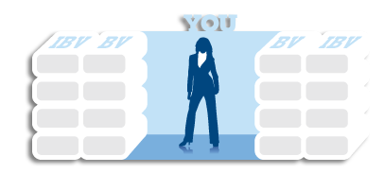
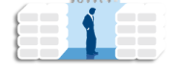
Cashback
Basic 5
ma Households
UFOs
Shopping Annuity
GO NOW
1
1
2
2
3
3
4
4
What you set in motion carries in motion carries in
motion creating duplication of what works

Slide 18
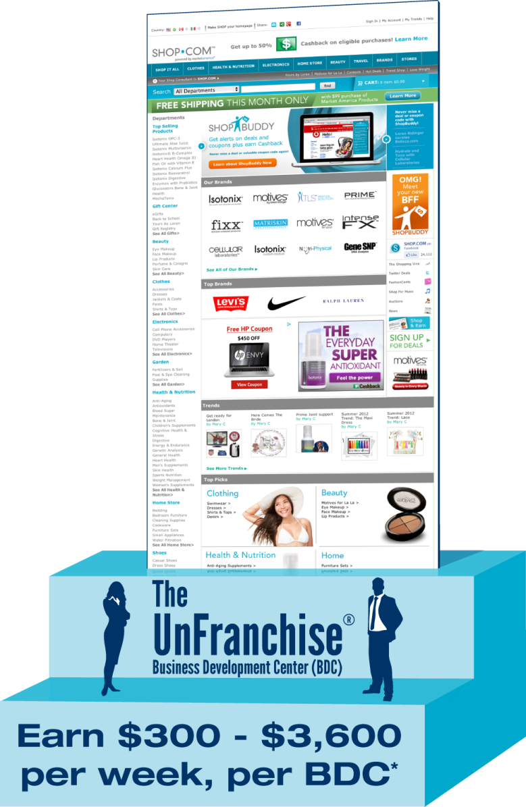
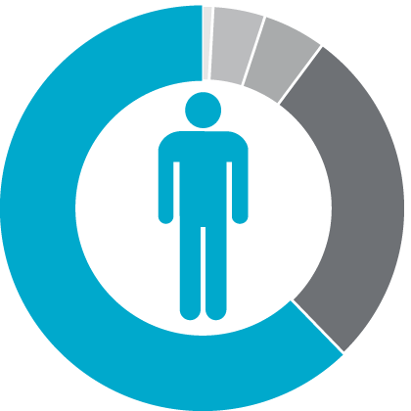
45 YEAR PLAN
2 TO 3 YEAR PLAN

Slide 19
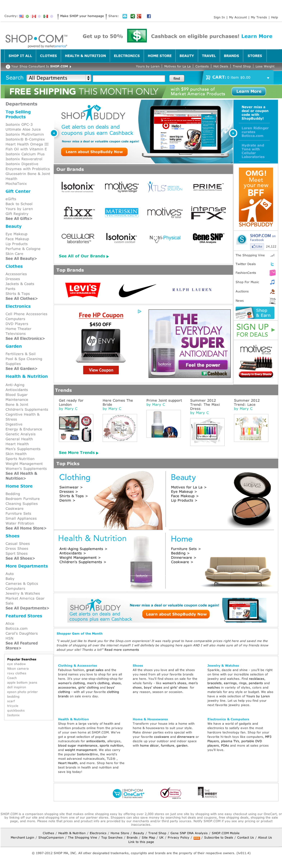


Hot Deals
Hundreds of Exclusive ma® Brands
eGifts
Social Networking
ShopBuddy

Slide 20
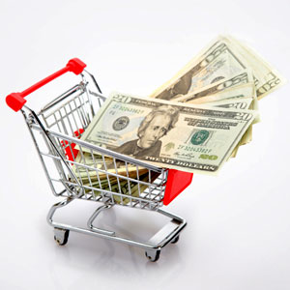

Paid To Shop
Paid To Share

Slide 21



Slide 22

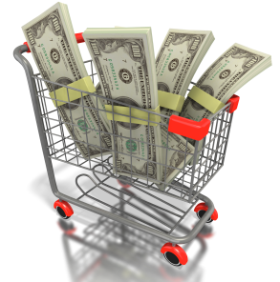
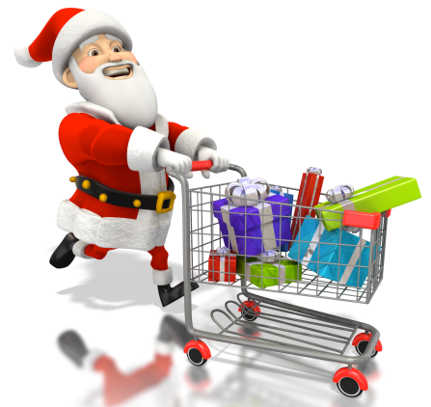

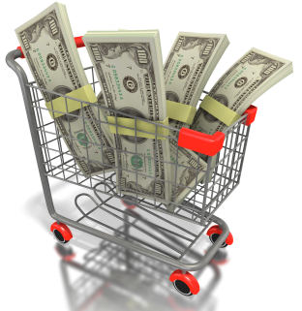

SHOP.COM
marketamerica.com
Earn CashBack
ma
cashback

Slide 23


Become a Product of the Product
Do you have an
Household?

Slide 24

Health Care
Supplements
Beauty & Personal Care
OTC Medications
BandAids/First Aid
Entertainment
& Travel
Home Care
Apparel

Slide 25
Health Care
Beauty & Personal Care
Supplements
BandAids/First Aid
OTC Medications
Entertainment
& Travel
Books, Music DVD’s, CD’s
Travel Ticket
Home Care
Apparel

Slide 26
Health Care
Supplements
Beauty & Personal Care
OTC Medications
BandAids/First Aid
Entertainment
& Travel
Books, Music DVD’s, CD’s
Travel Ticket
Household Cleaning
Home Décor & Maintenance
Home Care
Apparel

Slide 27
Health Care
OTC Medications
Supplements
Beauty & Personal Care
BandAids/First Aid
Entertainment
& Travel
DeoderantFragrance, Feminie Hygine
Books, Music DVD’s, CD’s
Cosmetic& Fragrance
Travel Ticket
Hats , Belts, Accesories
Household Cleaning
Undergarments, Shoes, Sneakers
Home Décor & Maintenance
Home Care
Apparel

Slide 28
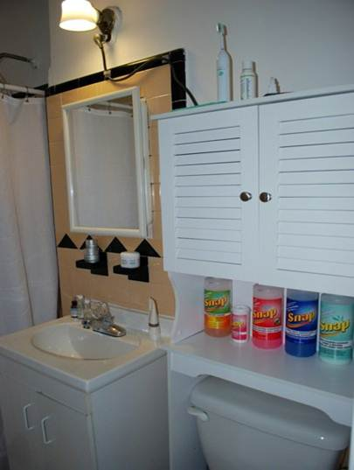
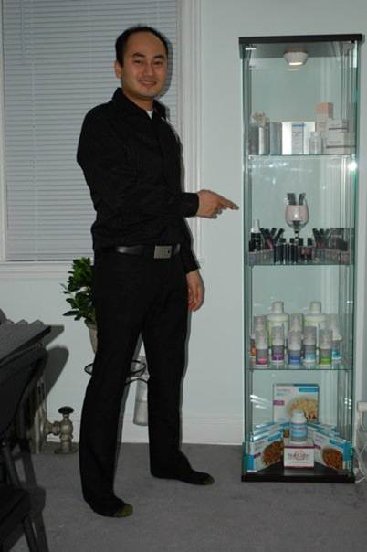
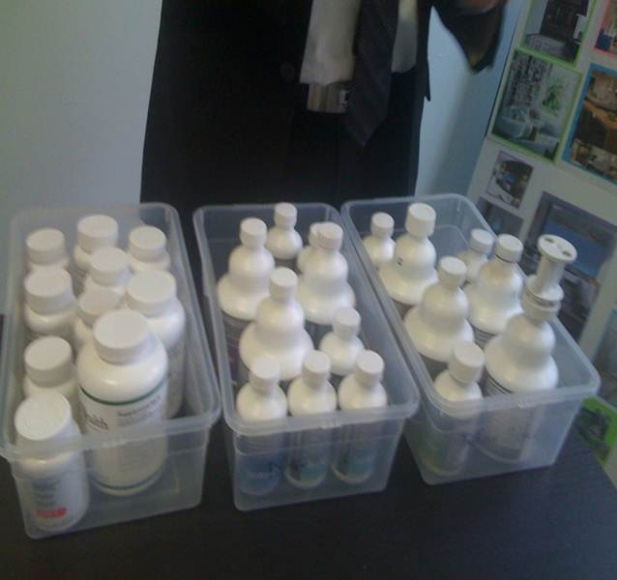
Woody’s MA Household

Slide 29
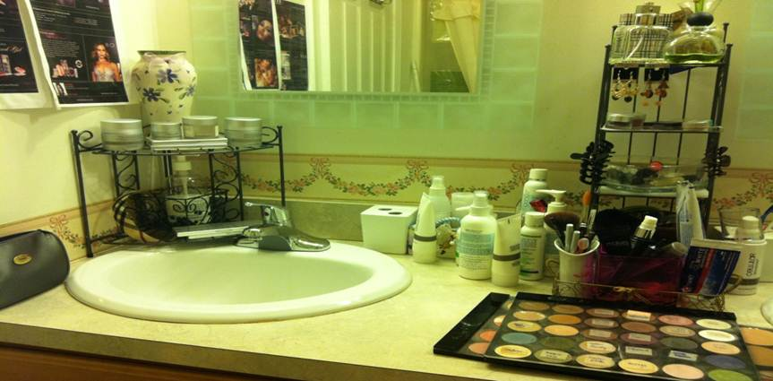
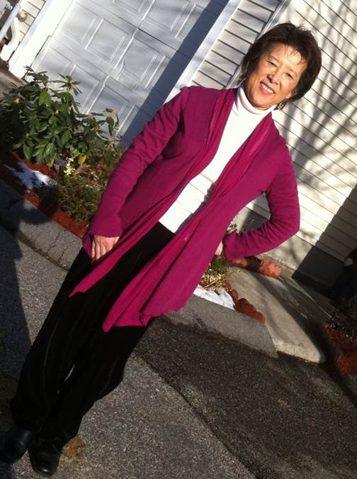
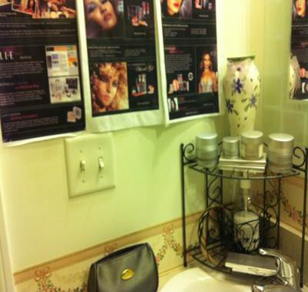
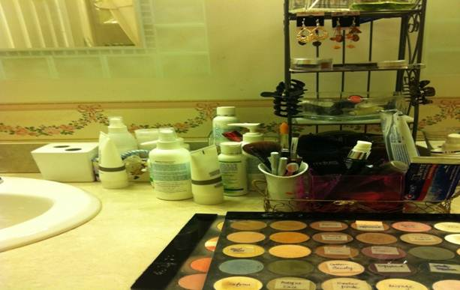
Laura’s MA Household

Slide 30
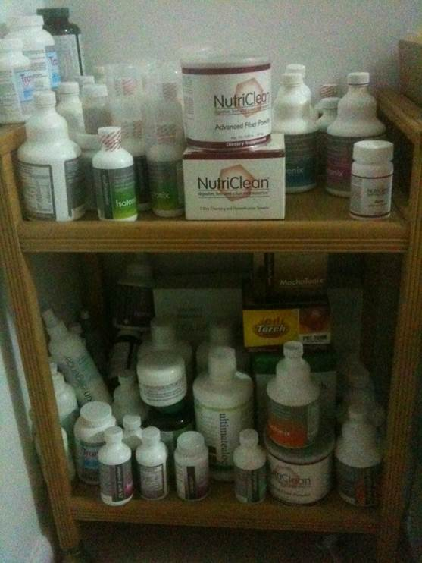
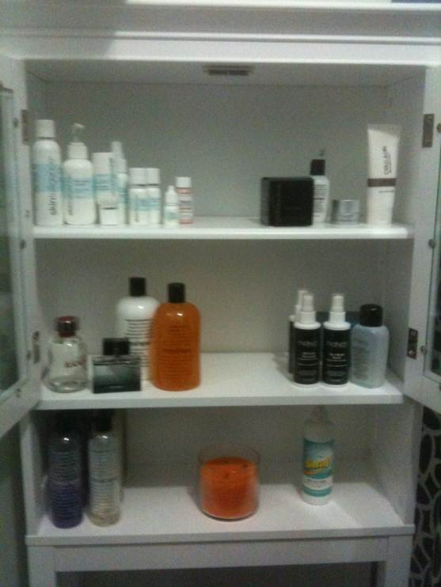
Joel’s MA Household

Slide 31
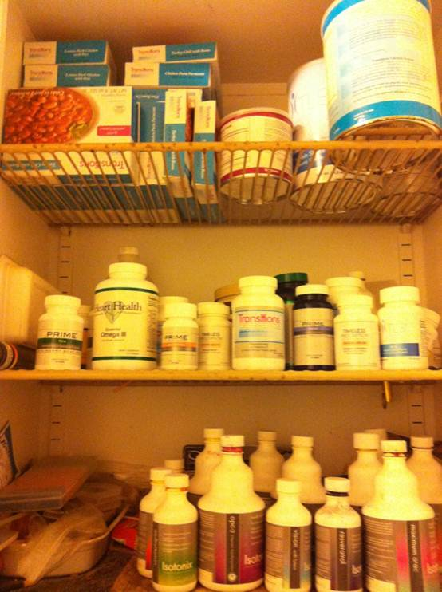
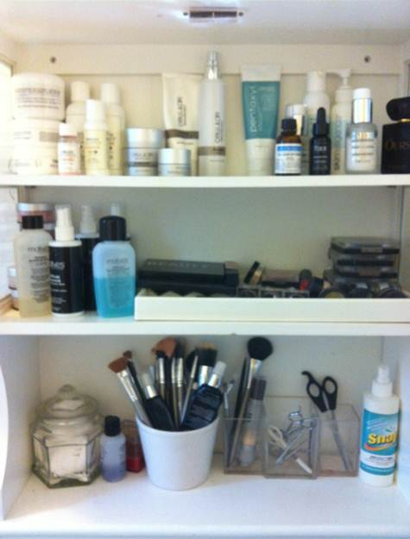
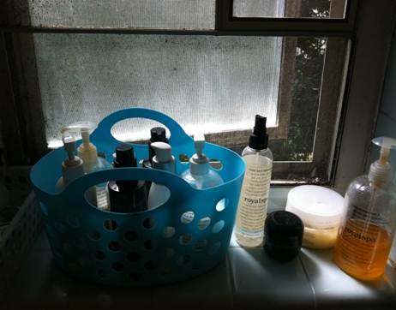
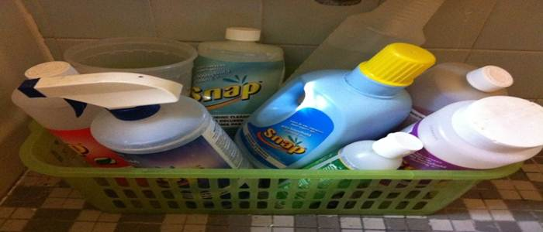
Lulu’s MA Household

Slide 32
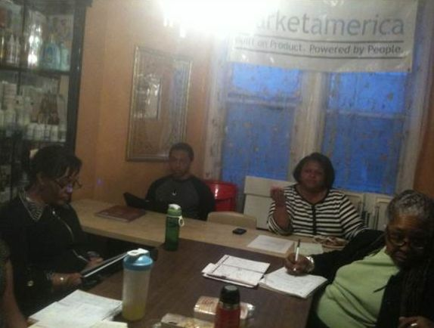
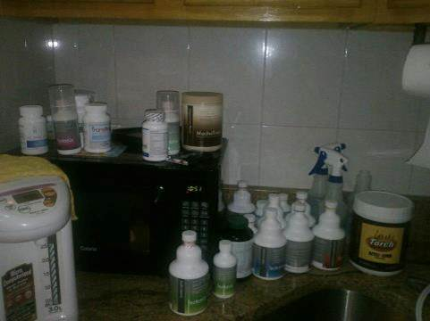
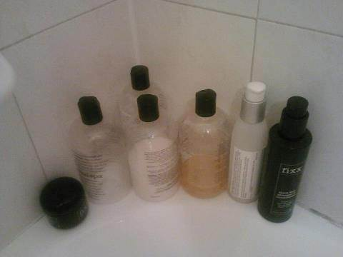
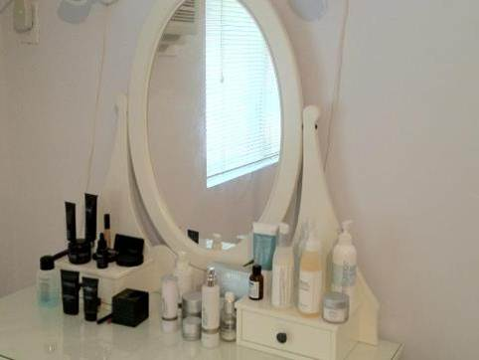
Doris, Yvelisse, and Kai have MA Households…

Slide 33
All of these Shop Consultants have MA Households…
DO YOU?

Slide 34
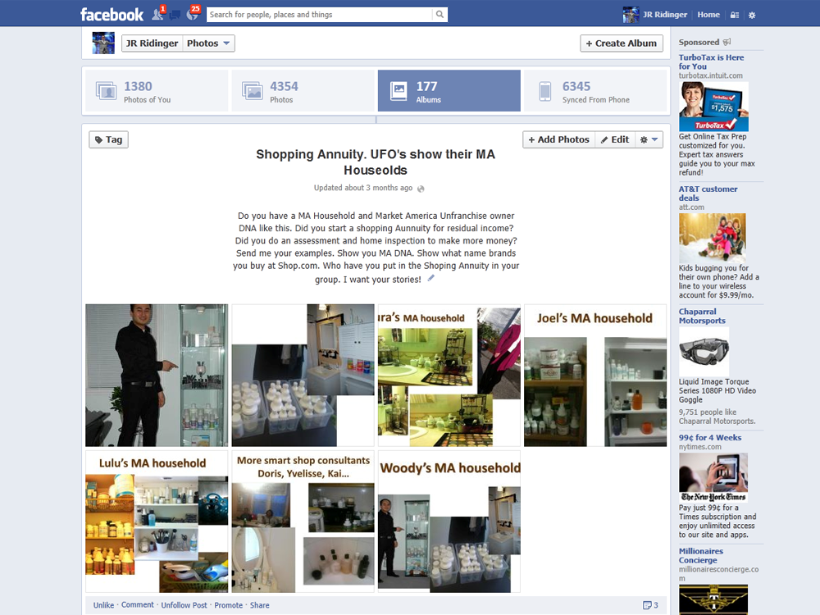

Slide 35
“What is that”?
This is the most powerful advertising that sells more product than any other single method!
Notes:
35

Slide 36

What’s That?

Slide 37
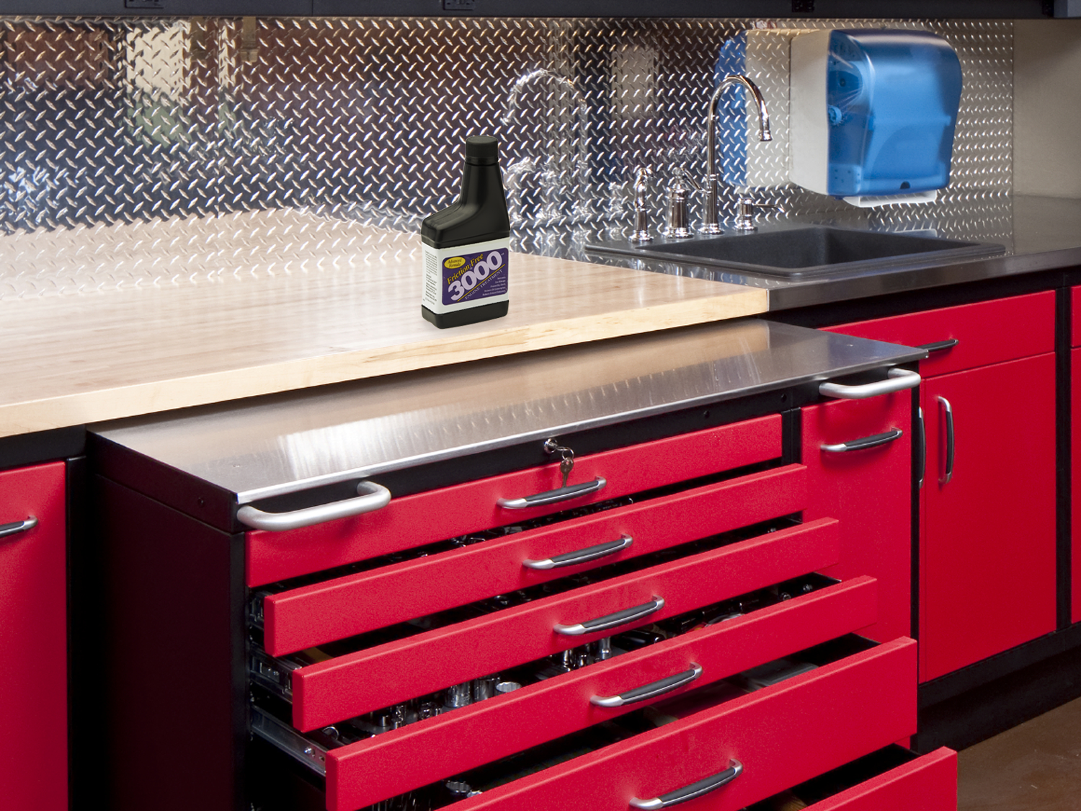
What’s That?

Slide 38

What’s That?

Slide 39
Look around the house at everything you bought the last few months…
Where did you buy it?
Can it be purchased at your store – the portal— Shop.com?
Notes:
39

Slide 40
INVETORY –SURVEY – ASSESSMENT
How much am I spending on what I buy?
Treasure Hunt for items that you can Fund your shopping annuity with!
Categories: In Home, family, activities, Life
  You are paying for it aren’t you?
TRANSFER BUYING! Doesn’t cost you anything!
FUNDING SHOPPING ANNUITY
CONVERT SPENDING INTO EARNING
Notes:
40

Slide 41
Categories: Home, family, activities, Life!
BV for MA Brands 1st.
IBV for Other Non MA Products=Brands on Shop.com
Kitchen and Pantry
Bathroom
Laundry Room
Living Area
Garage
Outdoors and Garden
MAJOR SPENDING Categories:
Electronics, appliances, gadgets, tools
Apparel and Accessories
Gifting
Entertainment, Travel, Music
Notes:
41

Slide 42
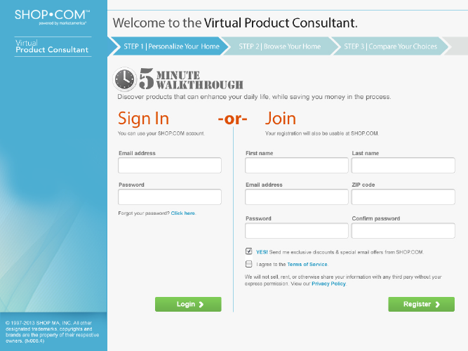




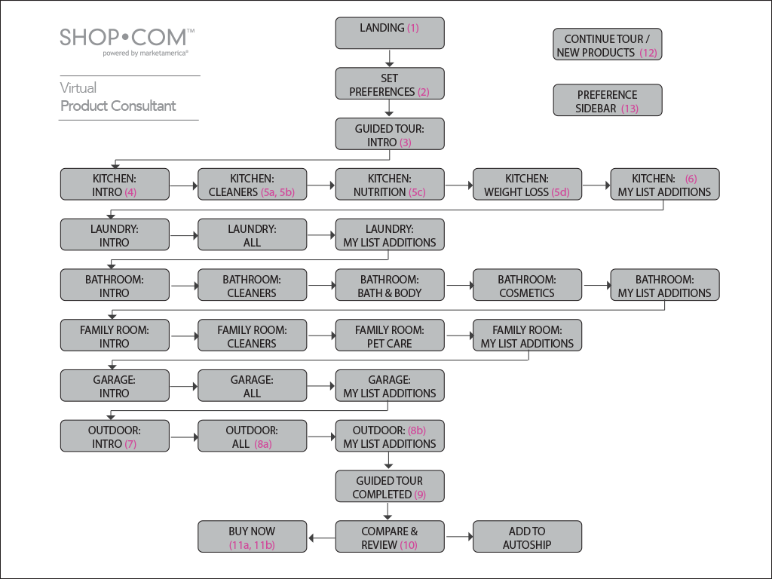
Notes:
42

Slide 43
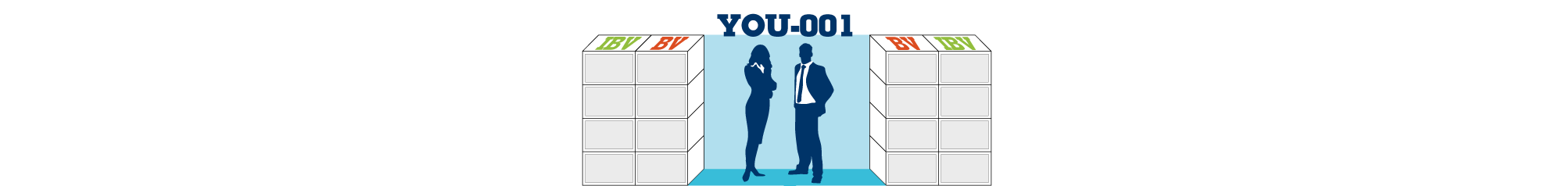
THE SHOPPING ANNUITY

Slide 44


Slide 45
“Turn spending into earning: Savings and convert shopping into income!”
Where else can you do this?
Notes:
45

Slide 46
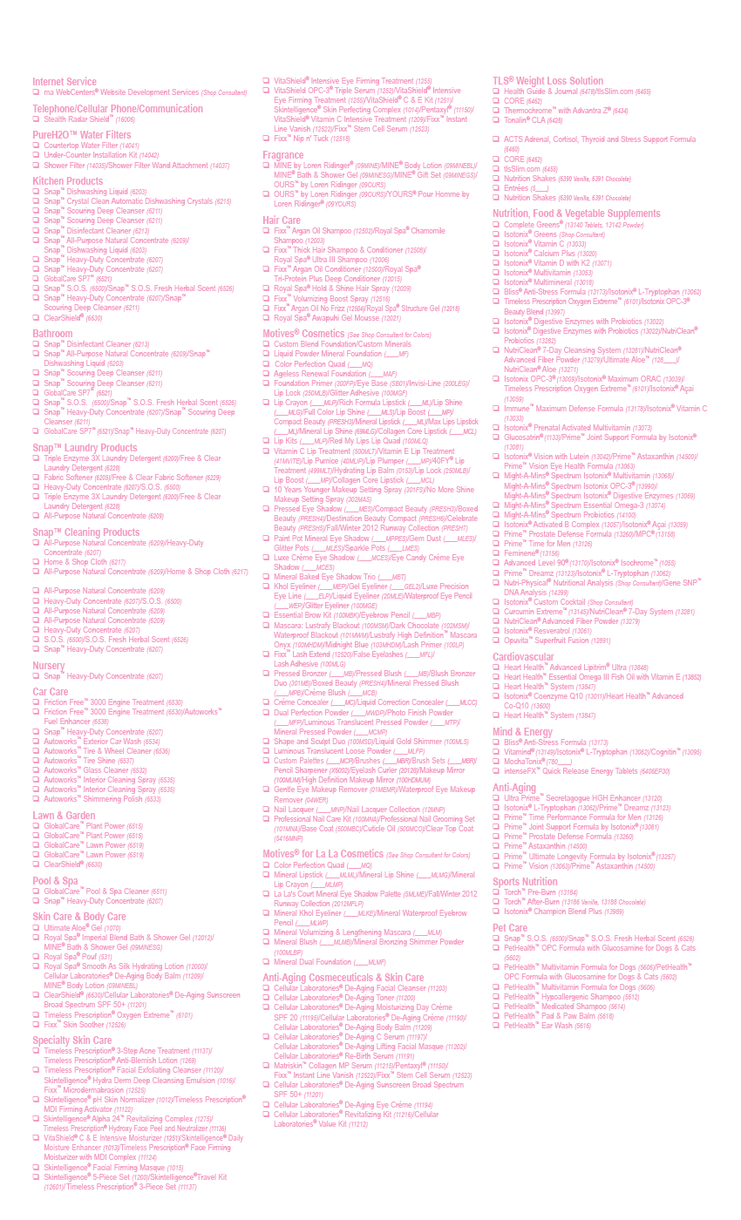
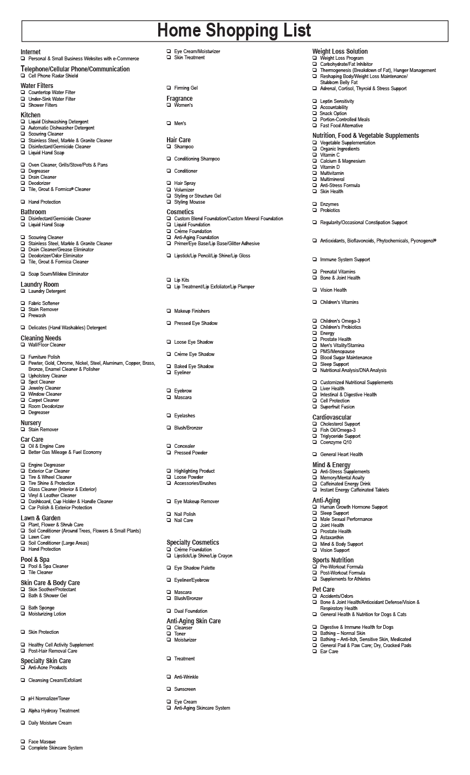
Home Shopping list
Notes:
46

Slide 47
Autoship
Why wouldn’t your committed UFO’s and organization want to do the same?
Notes:
47

Slide 48
The Result of not doing it? Default?
You Lose Checks!
Notes:
48

Slide 49
NEGATIVE PRODUCTS = (-) DEBITS
on Shopping Annuity
(-) Lost Cash Back
(-) Lost savings (cost comparison per use)
  (-) Lost Hot deals, Double CashBack, Coupons
  (-) Lost credibility = X ?
  (-) Lost how many “What’s that” (opportunities)?
  (-) Lifetime value of customers and viral spread of customers.
  (-) Lost Retail Profits?
  (-) Lost Duplication X ? People do what you do not what you say.
Notes:
49

Slide 50
NEGATIVE PRODUCTS = (-) DEBITS
on Shopping Annuity
(-)Lost BV or IBV! They reduce your BV and IBV (subtract) from what should be consumed and reduce your BV & IBV and your teams BV and IBV.
(-) You do not even buy your own products but go to another source and pay more.
(-) Take away from what you and your team earns.
(-)Sets wrong example so other’s do the same thing and results in “reverse duplication.
Same thing that makes the plan work from accumulation is in the reverse!
Notes:
50

Slide 51
NEGATIVE PRODUCTS = (-) DEBITS
on Shopping Annuity
(-)Lost BV or IBV! They reduce your BV and IBV (subtract) from what should be consumed and reduce your BV & IBV and your teams BV and IBV.
(-) You do not even buy your own products but go to another source and pay more.
(-) Take away from what you and your team earns.
Notes:
51

Slide 52
NEGATIVE PRODUCTS = (-) DEBITS
on Shopping Annuity
(-) You are wasting money AND losing money by paying more (retail) and not getting cash back, discounts, or BV credits towards checks.
(-)Sets wrong example so other’s do the same thing and results in “reverse duplication.”
(-)Same thing that makes the plan work from accumulation is in the reverse!
Notes:
52

Slide 53
NEGATIVE PRODUCTS = NOT SMART!
You Lose The Following Advantages:
You are not a product of the product and are not an advertisement or walking demonstration and testimonial.
When people see you use the product or solving a problem with a MA brand they ask “What is that
Base 10 7 strong becomes a no brainer
Notes:
53

Slide 54
NEGATIVE PRODUCTS = (-) DEBITS
NOT SMART! YOU LOSE THE FOLLOWING:
The shopping experience is important and you are a shop consultant or personal shopper and product broker to your customer and serve them by finding what they want at the best prices. Professional 1:1 marketer
Why would any UFO buy from WalMart brick and Mortar or Amazon other than they are negative?
You will be excited and want to share the experiences with your customers. Family, friends and group
Notes:
54

Slide 55
You Can’t Ride Two Horses to the
Finish Line

Slide 56

You Can’t Catch Two Rabbits at the Same Time!

Slide 57
You Can’t Have Your Feet in Two Canoes Going in Opposite Directions

Slide 58

You Can’t Paddle in Two Directions at the Same Time

Slide 59
NEGATIVE PRODUCTS =
The Result?
You Lose Checks!
Notes:
59

Slide 60


THE SHOPPING ANNUITY

Slide 61
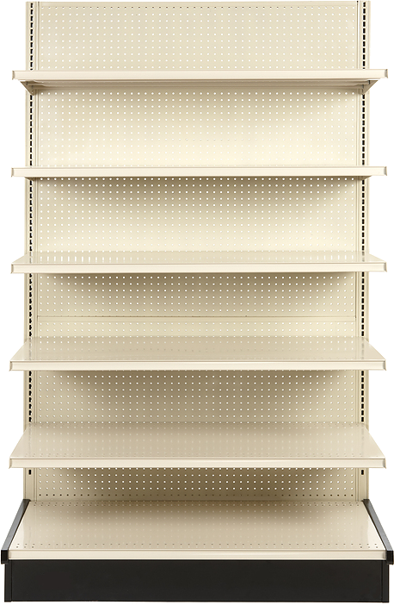
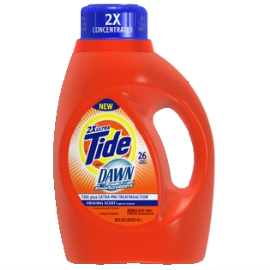
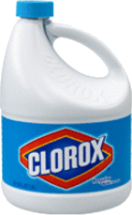
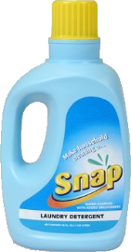

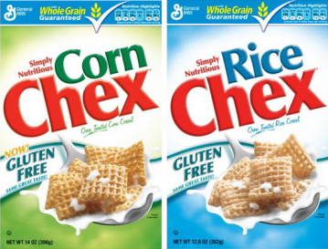


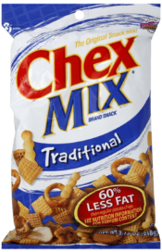
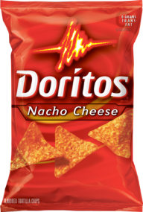
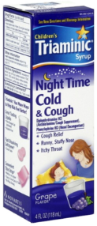
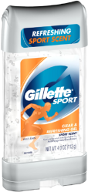
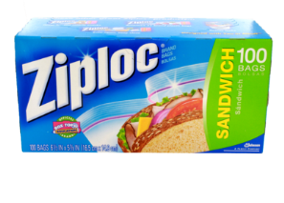
















Slide 62
The Shopping Annuity begins with
Transfer Buying.
Eliminate Negative Products!
Notes:
62

Slide 63

Three ways to earn income:
CASHBACK
Earn Cashback from your online transactions and your customers’
online transactions
PROVIDE PRODUCTS
Service 10-15 Preferred Customers
Earn 30-1,000% gross retail profit
TIME LEVERAGING
Duplicate efforts
Develop & manage only 2 sales and distribution organizations

Slide 64
Apparel
Department Stores
Sports & Outdoors
Home and Garden
Office Supplies
Consumables
Electronics, Toys & Games

Slide 65
Cashback
Customer Bait
Notes:
65

Slide 66

KITCHEN
Snap™ Dishwashing Liquid
Snap™ Crystal Clean Automatic Dishwashing Crystals
Snap™ Deep Scouring Cleanser
Snap™ Disinfectant Cleaner, Snap™All-Purpose Natural Concentrate
BV
12
Annuity Calculator
KITCHEN
12
BV = 0

Slide 67
KITCHEN
Large Isotonix Multivitamin
Large Isotonix OPC-3
Omega 3
Ultimate Aloe
BV
124
Annuity Calculator
KITCHEN
136
BV = 12

Slide 68

BATHROOM
Fixx™ Argan Oil Shampoo
Fixx™ Thick Hair Shampoo & Conditioner
Royal Spa Imperial Blend Bath & Shower Gel
Motives Rich Formula lipstick
Motives nail polish
Motives Mascara
Motives for La La Mineral Lip Shine
Motives Kohl eye liner
Motives Crème concealor
Motives Face Perfecting Primer
Motives Dual Perfection Pressed Powder
Motives Eyebrow Gel
Motives Foundation
Motives Blush
Motives eye shadow
Motives eye shadows
Motives eye pencil
Motives makeup remover
Motives Bronzer Motives Bronzing Lotion
BV
29.5
BV
103
Annuity Calculator
KITCHEN
239
BV = 136

Slide 69

BATHROOM
Lumiere de Vie Eye Balm
Lumiere de Vie Illuminating Fading Fluid
Lumiere de Vie Serum Concentrate
Lumiere de Vie Volcanic Exfoliating Mask
Lumiere de Vie Intense Rejuvenation Crème
BV
115
Annuity Calculator
KITCHEN
354
BV = 239

Slide 70

LAUNDRY
Snap™ Triple Enzyme 3x Laundry Detergent
Snap™ Triple Enzyme 3x Laundry Detergent
Snap™ Fabric Softener
BV
12
Annuity Calculator
KITCHEN
366
BV = 354

Slide 71

PET HEALTH
PetHealth™ Multivitamin Formula for Dogs
OPC Formula with Glucosamine for Dogs & Cats
PetHealth™ Hypoallergenic Shampoo
Pad & Paw Balm & Ear Wash
BV
17
Annuity Calculator
KITCHEN
383
BV = 366

Slide 72

GARAGE
Autoworks™ High Performance Auto Care Shimmering
Autoworks™ High Performance Auto Care Exterior Car Wash
Autoworks™ High Performance Auto Care Tire & Wheel Cleaner
Autoworks™ High Performance Auto Care Tire Shine
Autoworks Interior Cleaner
Autoworks Fuel Enhancer & Friction Free
BV
22
Annuity Calculator
KITCHEN
405
BV = 366

Slide 73
The Average U.S. Household has a monthly expenditure of $4,009.00
After all average expenses are paid (like mortgage, insurance & car payment etc.) that can not be purchased on the shopping annuity
The Average family is already purchasing $1385 per month that could be transferred to the Shopping Annuity
Notes:
73

Slide 74
200 BV?
Family of three to four
Large OPC-3
52 BV
Omega III
33 BV
Large Multivitamin
31 BV
Large B-Complex
30 BV
Calcium
8.5 BV
Fix Shampoo & Conditioner
9 BV
Hydra Derm Deep Cleaning Emulsion
7.25 BV
Pentaxyl
47 BV
Pet Health
11.25 BV
Laundry Detergent
5.25 BV
Total = 234.25 BV

Slide 75
5 Categories of Normal Spending for Everyone:
  Consumable products you replace MA brands for store brands. How many can you find?
  MA products that you may not have used but discovered that have huge benefit and build your business. You WANT these products.
  All consumables in your house and work that are not MA brands—Get from Partners on Shop.com – My list
  Gifts. Everyone buys Xmas, Birthdays, Valentines day, Anniversaries, Mothers Day and Fathers day.
  Annual purchases: Apparel, electronics, gadgets, tools, appliances, Furniture, shoes, accessories, sporting goods
Notes:
75

Slide 76


Retailing Goal – Base 10, Seven Strong
After Three-Six Months, Earn > $300/Monthly (BV) and Earn $300 every 2nd month (IBV)
1200 BV & 825 IBV
1200 BV & 825 IBV
400 BV & 275 IBV
400 BV & 275 IBV
400 BV & 275 IBV
400 BV & 275 IBV
400 BV & 275 IBV
400 BV & 275 IBV
IBV based on 10 customers doing 20 IBV and you doing 75 IBV personally
Notes:
76
76

Slide 77


Here’s what could happen as your Organization grows to 30 UFOs
= $1500 to $2100 month (BV) & $600/$900 IBV
15 x 400 BV | 15 x 275 IBV
=6000 BV | =4125 IBV
15 x 400 BV | 15 x 275 IBV
=6000 BV | =4125 IBV
$1500 to $2100 /month (BV) & $900 to $1500 IBV =
$2400 to $3600 per month
Notes:
77
77

Slide 78
Here’s what could happen as your Organization grows to 50 UFOs
$1500 to $2100 month (BV)
& $600/$900 IBV
50 x 400 BV | 50 x 275 IBV
=20000 BV | =13750 IBV
50 x 400 BV | 50 x 275 IBV
=20000 BV | =13750 IBV
$1500 - $2100 Week (BV) & $3300 - $3900 month (IBV) = $12,300/month
Notes:
78
78

Slide 79


Adding PC’s to Your Shopping Annuity
Here’s what could happen to BV
50,000 BV
50,000 BV
$
BV = $32,000 per month
IBV = $12,000 per month
Plus Cashback
BV = $32,000 per month
IBV = $12,000 per month
Plus Cashback
Notes:
79

Slide 80
The Shopping Annuity begins with Assessment in order to do
Transfer Buying.
YOU - Just do it – This week
How many Assessments did you do in your group this week?
How many Shopping Annuities in your organization this month?
Notes:
80

Slide 81
You still doubt, hesitate or are not sure?
How do I know I save money?
Show me the money?
Notes:
81

Slide 82
If we can prove that you save money will you put it in the Shopping annuity?
Will you get your Team to do it?
Will your do the Home inspection?
Will you become a UFO MA Household
Will you get rid of negative products
Will you do the Home Shopping list and convert it to MY list? Auto Ship?
Will you convert your Team and PC’s?
Notes:
82

Slide 83


Slide 84



Slide 85


Slide 86


Slide 87


Slide 88


Slide 89


Slide 90


Slide 91


Slide 92


Slide 93


Slide 94


Slide 95


Slide 96


Slide 97


Slide 98


Slide 99


Slide 100


Slide 101


Slide 103


Slide 104


Slide 105


Slide 106
Shop Savings Sheet
Our Products | Grocery Store Brand | Number Of Uses Or Size | Our Products Cost Per Use | Grocery Store Cost Per Use | Savings With Our Company
Dishwashing Liquid (Snap Dishwashing Liquid) | Liquid Dishwashing Soap (Dawn) | 32oz. | $0.23 | $0.25 | 8%
Dishwashing Detergent (Snap Automatic Dishwashing Crystals ) | Dishwasher Detergent (Cascade) Clothing Brightener (Clorox 2) | 30oz. | $0.04 | $0.10 | 60%
Laundry Detergent (Snap Laundry Detergent Triple Enzyme) | Laundry Detergent- (Tide) | 40oz. | $0.12 | $0.24 | 50%
Oder & Stain Remover (Snap SOS Original Scent) | Stain Remover (Shout/Spray & Wash) Odor Remover (Febreze) | 8oz. | $1.10 | $1.46 | 25%
All Purpose Cleaner (Snap All Purpose Natural Concentrate) | Hand Soap (Soft Soap) Furniture Polish (Murphy's Oil) | 32oz. | $0.23 | $0.36 | 36%
Disinfectant (Snap Disinfectant Cleaner) | Disinfectant (Lysol) | 32oz. | $0.10 | $0.31 | 97%
Industrial Cleaner (Snap Scouring Deep Cleanser) | Scouring Cleanser (Soft Scrub) | 32oz. | $0.23 | $0.30 | 23%
Power Cleaner (Snap Heavy Duty Concentrate) | Power Cleanser (Tilex) | 32oz. | $0.37 | $1.32 | 72%
Engine Treatment (Friction 3000 Engine Treatment) | Engine Treatment (H2Oil Fuel Treatment) | 8oz. | $2.49 | $3.75 | 34%
Fuel Enhancer (Auto Works Fuel Enhancer) | Fuel Booster (MPG Booster) | 8oz. | $2.49 | $3.49 | 29%
Car Wash (AutoWorks Exterior Carwash) | Car Wash (Pinnacle) | 32oz. | $0.58 | $0.70 | 17%
Lotion (Royal Spa Hydrating Lotion) | Lotion (Cetaphil) | 16oz. | $0.94 | $1.25 | 25%
Shampoo (Fixx Argan Oil Shampoo) | Shampoo (MoroccanOil) | 8oz. | $1.75 | $2.52 | 31%
Hair Conditioner (Fixx Argan Oil Conditioner) | Conditioner (Moroccan Oil Conditioner) | 8oz. | $1.75 | $2.00 | 13%
Shower Gel (Royal Spa Shower Gel) | Shower Gel (Bath & Body Works) | 16oz. | $0.55 | $1.50 | 63%
Hair Spray (Royal Spa Hold & Shine Hair Spray) | Pump Hair Spray (Fakki) | 8oz. | $0.88 | $3.16 | 72%

Slide 107
WHY didn’t anyone do this before?
Notes:
107

Slide 108

Additional Benefit
The power of numbers!
Notes:
108

